Slide 1

Restaurant Rating Prediction
By,
Ankita Yadav
Omkar Sanas
Pitch

Slide 2

Introduction & Objective
What is the Project About? Predicting restaurant ratings using machine learning Analyzing Zomato’s Bengaluru dataset Extracting trends in customer preferences Helping Zomato improve service and recommendations Objective: Build models to accurately predict ratings. ​
About

Slide 3

Dataset & Features
Methodology Data Preprocessing : Cleaned nulls, removed duplicates, encoded features Models
Used : EDA Linear Regression, Decision Tree,
Regressor Tools : Python, VS Code, Pandas,
Matplotlib, Seaborn, Scikit-learn, NumPy
​

Slide 4

PROBLEM STATEMENT
Perform extensive Exploratory Data Analysis (EDA) on the Zomato Dataset.
For the modelling part, use
• Linear Regression
• Decision Tree Regressor
• Random Forest Regressor
• Support vector Regressor
• Extra Tree Regressor.
​
​

Slide 5

Insights from EDA
Top cuisines: North Indian, Chinese, South Indian
Popular restaurants: Empire, Onesta,kfc
KFCTop locations: Koramangala, BTM, IndiranagarMost places accept online orders & table booking
Business
​

Slide 6
SOFTWARE AND HARDWARE REQUIREMENTS
Hardware Requirements :
 RAM : 4 GB or higher
 Disk Space : Min 20 GB (free)
 Peripheral Devices : Monitor, Mouse and Keyboard
Software Requirements :
 Operating system : Windows 8 or higher.
 IDE Tool : Visual Studio Code
 Coding Language : Python
 Libraries : Numpy, Pandas, Seaborn, Matplotlib, Scikit-learn

Slide 7
ADVANTAGES AND DISADVANTAGES
Advantages :
Enhanced Decision-Making for Restaurants
Improved Customer Experience
Business Insights
Customized Recommendations
Disadvantages:
Data Limitations
Complexity of Features
Model Overfitting
Changing Restaurant Dynamics

Slide 8
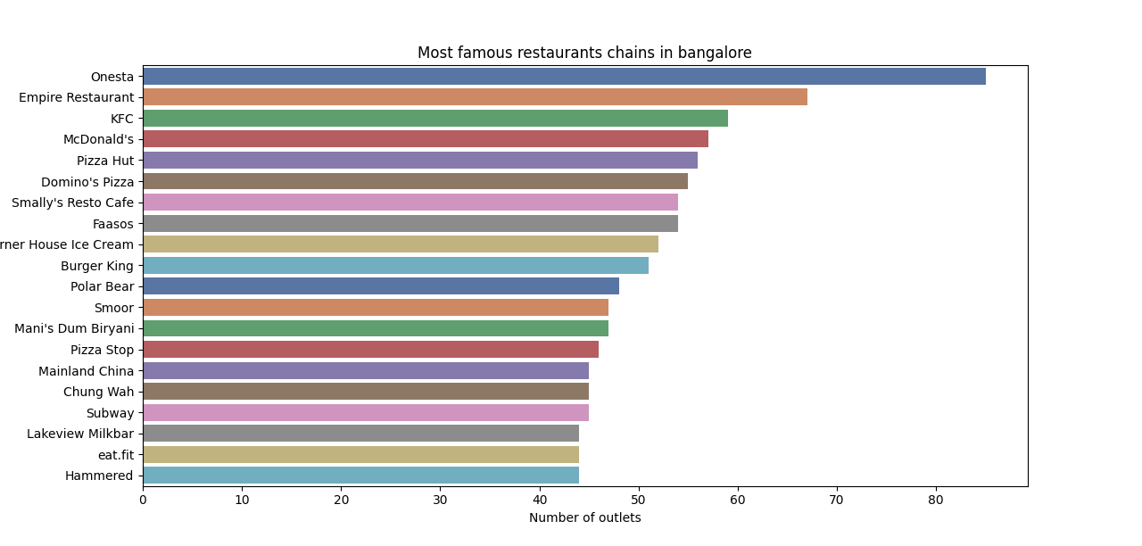
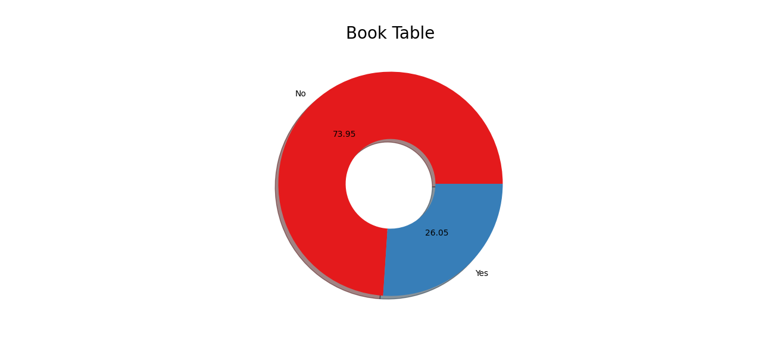
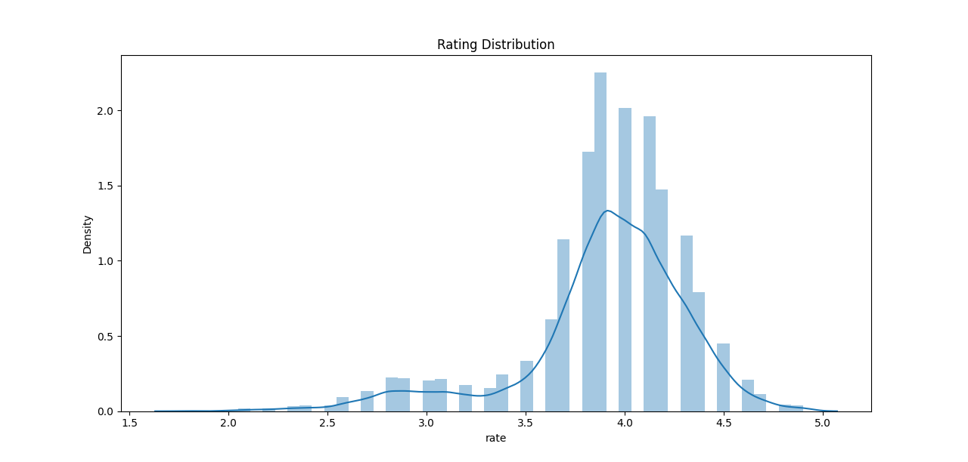
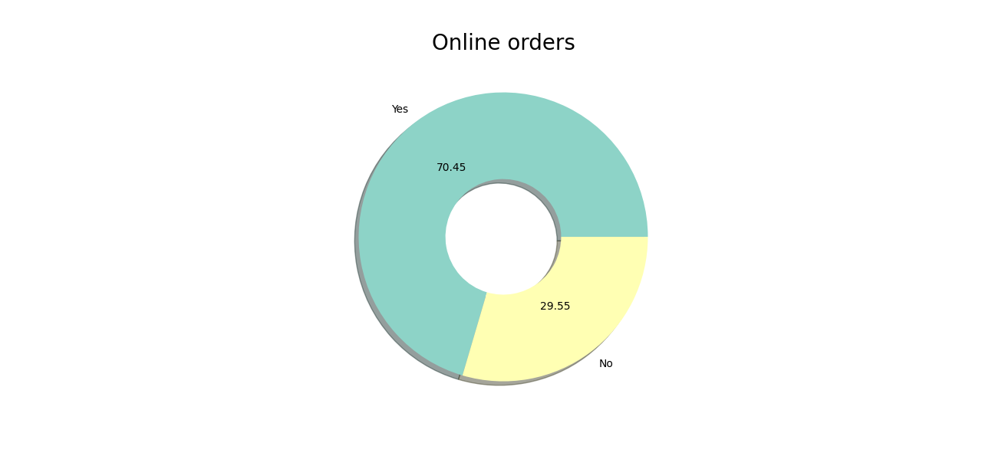
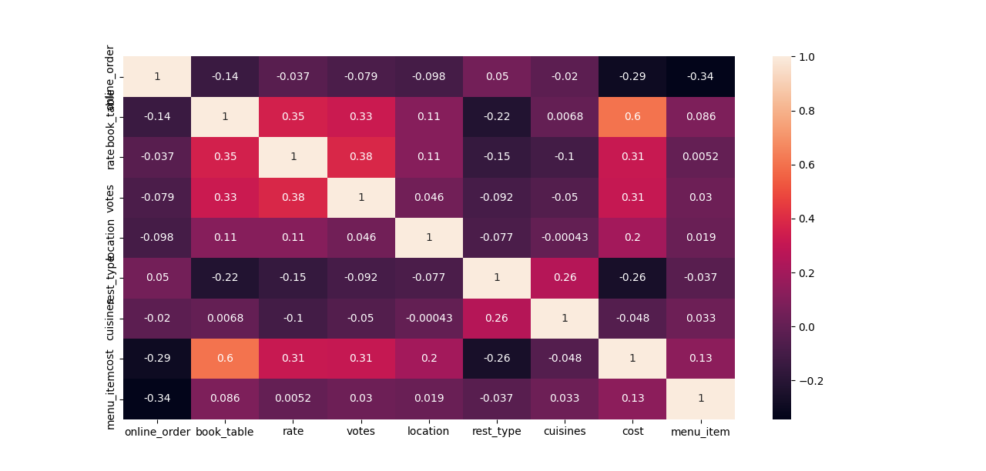
OUTPUT

Slide 9
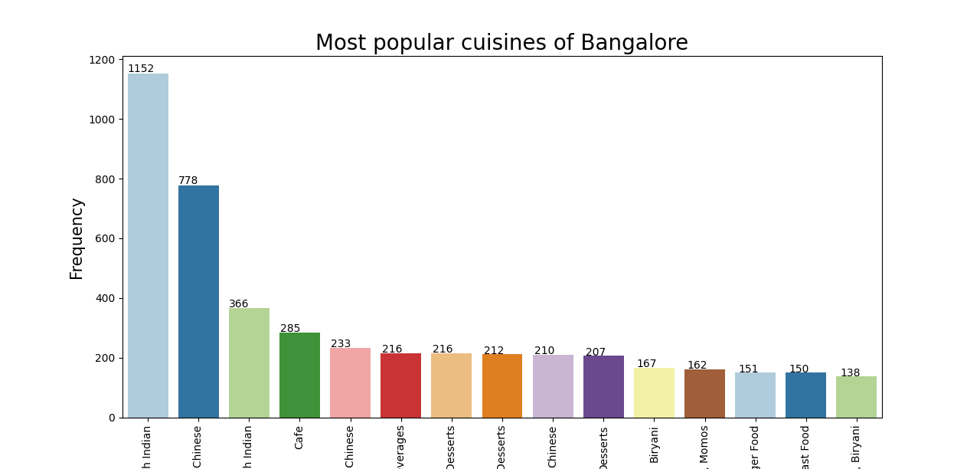
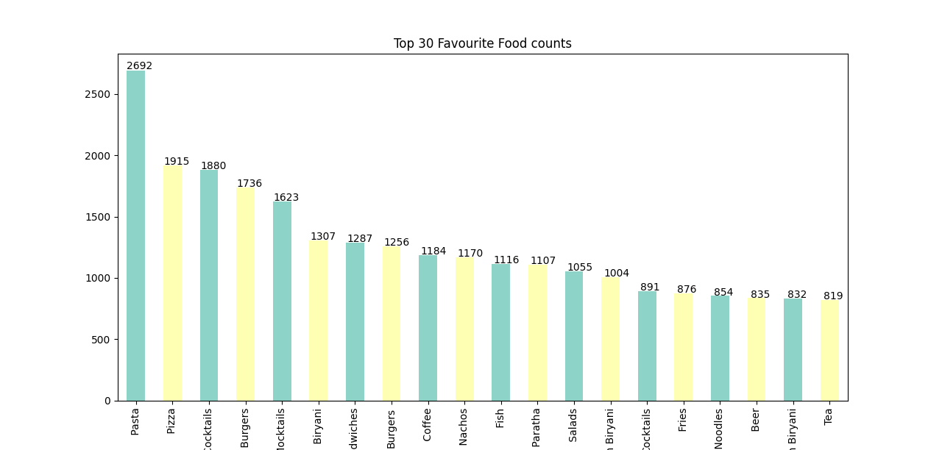
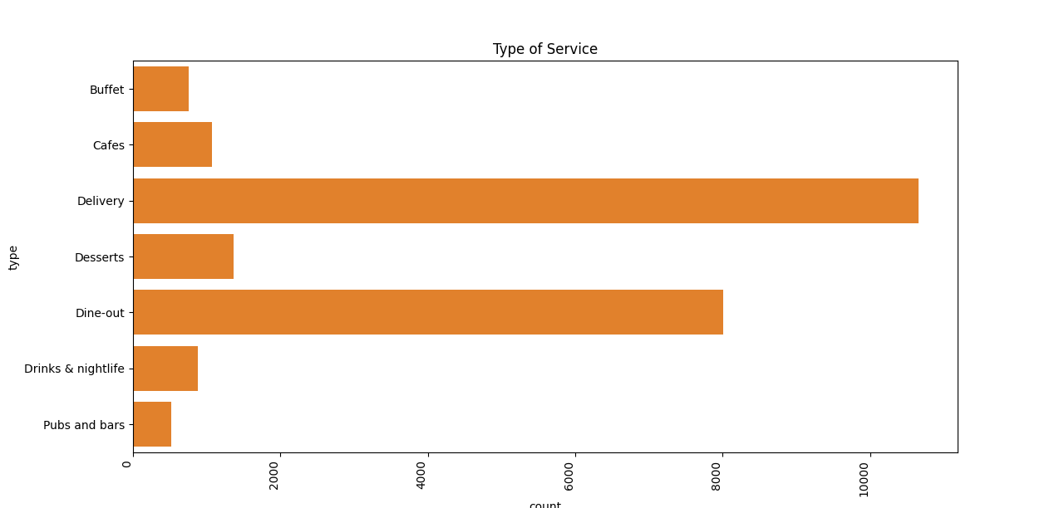
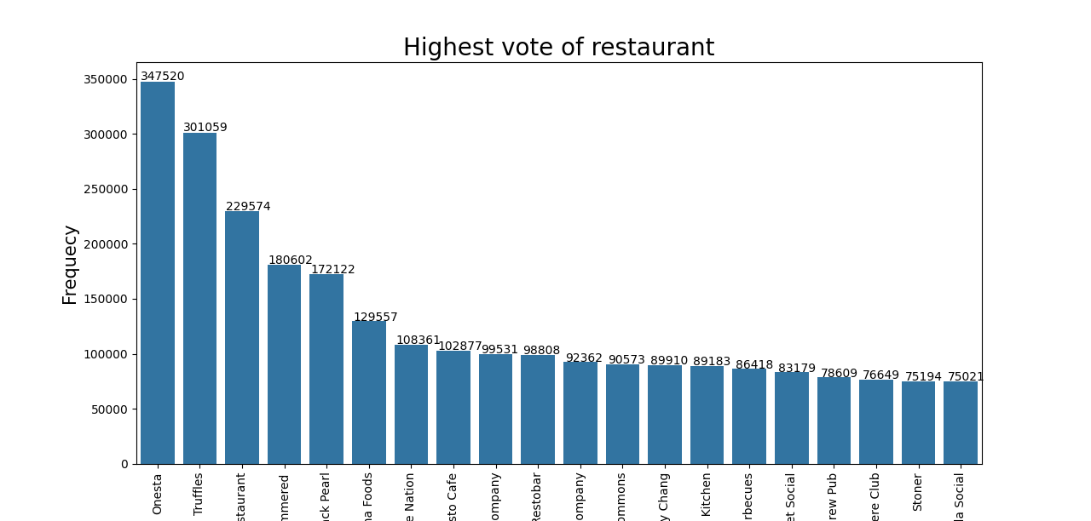
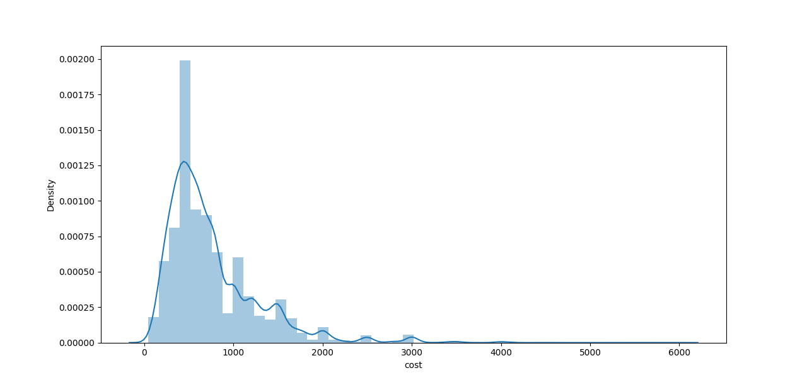
OUTPUT

Slide 10

Thank YOU
Yadav Ankita
Mhamane Kiran
Than

